Slide 1

Interactive Dashboards for Student Placement Storytelling
Ashish Kalaskar(202501110176) & Aryan Bhosale(202501110179)DATA VISUALISATION Lab Project
A23 BATCH AL2 DIVISION

Slide 2

Project Overview and Objectives
Problem Statement
Project Goal
Traditional placement data analysis is static, fragmented, and lacks the depth needed for actionable, strategic insights.
Develop an interactive Power BI dashboard to visualise placement trends, identify high-potential candidates, and track programme performance.
Key Features
Dynamic placement statistics, student performance analysis, and data-driven insights to support strategic academic decision-making.

Slide 3
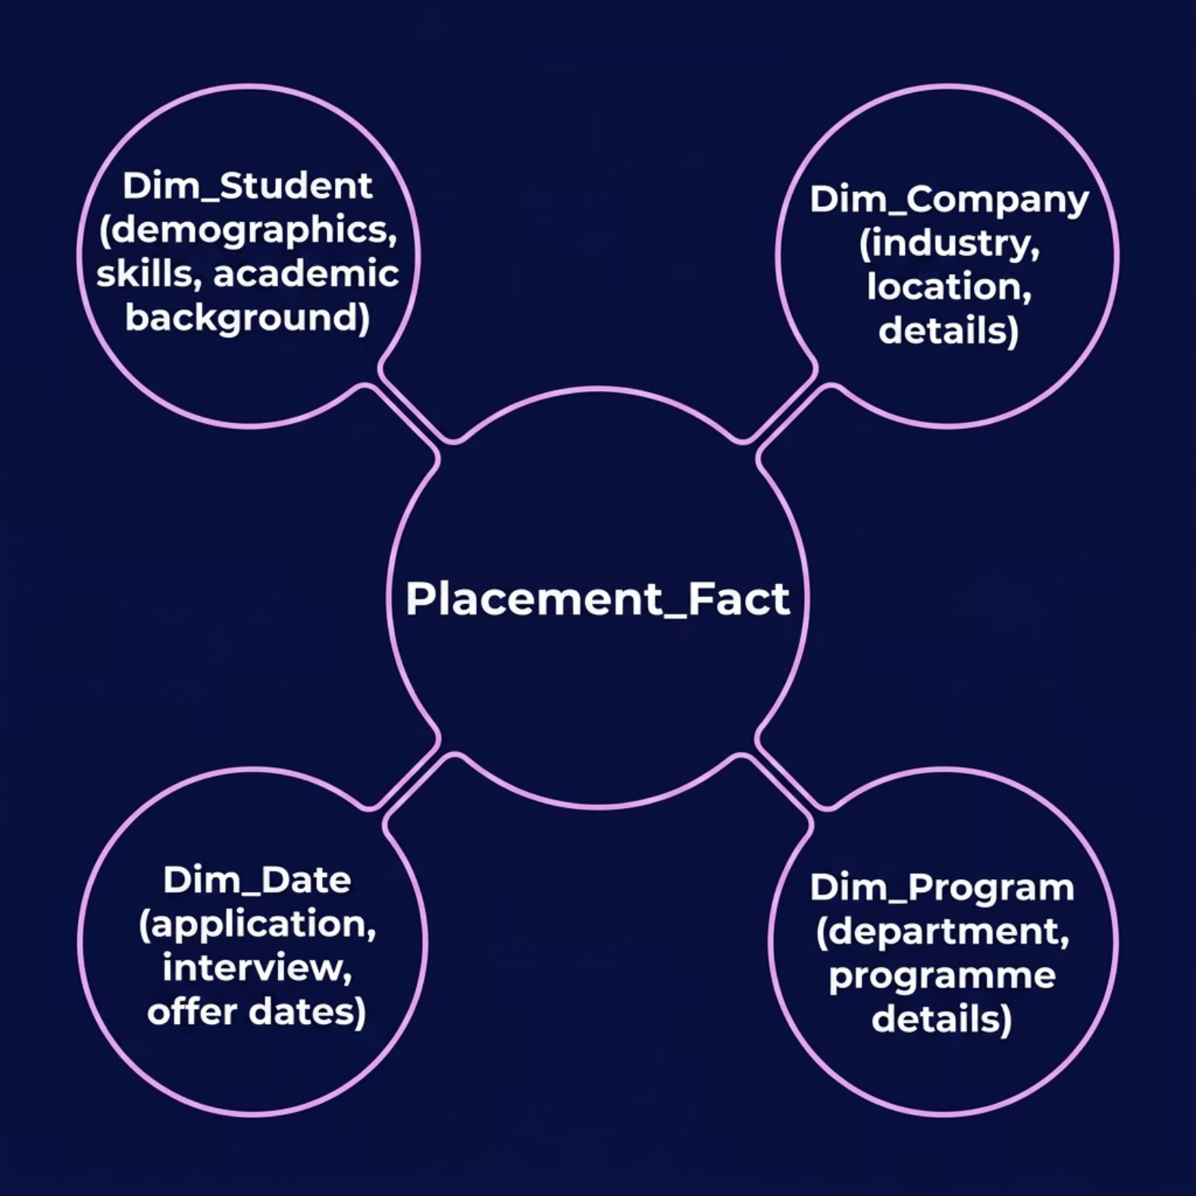


Data Modelling: The Star Schema Foundation
Fact Table: Placement_Fact
Contains transactional records — Student ID, Application ID, Interview Status, Offer Status, and Salary.
Why Star Schema?
Optimised for OLAP and business intelligence workloads. Simplifies DAX queries and significantly improves analytical performance for large datasets.
Each dimension table surrounds the fact table, enabling fast, intuitive slicing and filtering across all placement metrics.

Slide 4


Feature Engineering: Skill Scores
Objective
Composite Score Formula
Quantify student employability through a composite, weighted skill metric derived from individual profiles and résumés.
Methodology
High Skill Scores directly feed the High Performers DAX measure, enabling objective, bias-free candidate ranking across all programmes.
01
02
03
Skill Extraction
Skill Weighting
Score Aggregation
Identify key skills from student profiles and résumés.
Assign weights based on industry demand and programme relevance.
Compute composite Skill Score per student.

Slide 5
DAX Measures: Quantifying Placement Success
Placement Rate
What These Measures Reveal
Placement Rate =
DIVIDE(
COUNTROWS(
FILTER('Placement_Fact',
'Placement_Fact'[Offer_Status]
= "Placed")),
COUNTROWS('Placement_Fact')
)
Placement Rate
Percentage of students who received a confirmed offer — the primary KPI for placement health.
High Performers
Count of students whose Skill Score exceeds the cohort average — flags top candidates for recruiters.
High Performers
High Performers =
CALCULATE(
COUNTROWS('Dim_Student'),
FILTER(Dim_Student,
Dim_Student[Skill_Score]
> [Average_Skill_Score])
)
Additional Measures
Average Salary, Interview Conversion Rate, Programme Placement Success.

Slide 6


Interactive Dashboard Design in Power BI
KPI Cards
Overall Placement Rate, Average Salary, and Total Placed Students — at-a-glance executive summary.
Bar & Donut Charts
Placement by Programme, Industry, and Skill Score distribution; Donut charts for skill proficiency breakdowns.
Dynamic Slicers
Filter by Year, Programme, Company, and Skill Category for fully interactive, context-driven exploration.
Matrix / Detail Table
Granular student-level placement status, offer details, and company information for in-depth review.

Slide 7

Publishing to Power BI Service
Key Benefits of Cloud Deployment
Accessibility
View reports on any device, anywhere, via browser or mobile app.
Collaboration
Team workspaces enable joint editing, comments, and version control.
Save .pbix
Publish
Schedule Refresh
Share
Real-Time Insights
The end-to-end publishing pipeline ensures reports are always current, accessible, and securely shared with decision-makers.
Scheduled refreshes keep placement data current for all stakeholders.

Slide 8
Mapping to Sustainable Development Goals
SDG 4
SDG 8
Quality Education
Decent Work & Economic Growth
Target 4.4: Increase youth with relevant technical and vocational skills for employment and entrepreneurship.
Target 8.5: Achieve full and productive employment, including equal pay for young people and persons with disabilities by 2030.
This dashboard identifies skill gaps and informs curriculum design, ensuring academic programmes remain aligned with evolving industry needs.
By facilitating better, data-informed placements, the project directly contributes to increased employment opportunities and inclusive economic growth.

Slide 9


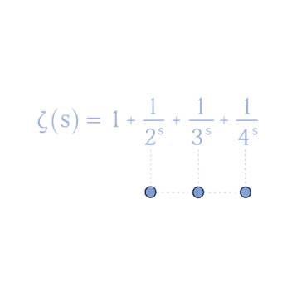

Technical Stack and Tools
Data Source
Power Query (M)
DAX Measures
Power BI Desktop & Service
Excel / CSV files (simulated academic dataset) representing student profiles, company records, and placement outcomes.
ETL transformations — cleaning, reshaping, and loading data into the Star Schema model efficiently.
Data Analysis Expressions for Placement Rate, High Performers, Average Salary, and Conversion Rate KPIs.
Authoring in Power BI Desktop; cloud deployment and stakeholder sharing via Power BI Service.

Slide 10

Conclusion and Future Work
Key Takeaways
Future Enhancements
Interactive dashboards unlock powerful storytelling capabilities for complex placement data.
Real-Time HR Integration
Predictive Analytics
Forecast future placement trends using time-series and regression models.
A robust Star Schema and well-defined DAX measures are the foundation of accuracy and performance.
Live data feeds from HR and campus recruitment systems.
Feature-engineered Skill Scores add measurable analytical depth to candidate evaluation.
AI/ML Skill Gap Analysis
Advanced models for personalised career path recommendations.
This project demonstrates how engineering rigour and data storytelling together can drive meaningful academic and societal impact — aligned with both SDG 4 and SDG 8.

